Slide 1
Sistem Mikroprosesor II
Ilmawan Mustaqim

Slide 2
Sistem Mikroprosesor II
Mata kuliah ini merupakan bagaian dari mata kuliah Sistem Mikroprosesor
SisMik (3 sks) dibagi menjadi : Sist.Mikroprosesor Z80 (2 sks) dan Sist. Mikrokontroler AVR ATmega16 (1sks)
Praktikum Mikroprosesor jg meliputi praktikum mikrokontroler
Kuliah SisMik II dilakukan selama 4 jam sehingga presensi 4 kali dengan jumlah pertemuan 2 kali per minggu sehingga dapat diselesaikan dalam waktu 2 minggu.

Slide 3
Sistem Mikroprosesor II
Deskripsi :
Mata kuliah ini mempelajari tentang arsitektur mikrokontroler AVR ATmega16 , pemrograman mikrokontroler berbasis bahasa C (Codevision AVR + Proteus), pemahaman antar muka dan projek sederhana berbasis ATMega16

Slide 4
Sistem Mikroprosesor II
Kompetensi :
Mahasiswa paham tentang sistem mikrokontroler ATMega16 dan pemrogramannya berbasis bahasa C serta mampu menganalisa dan membuat sistem aplikasi mikrokontroler sederhana.

Slide 5
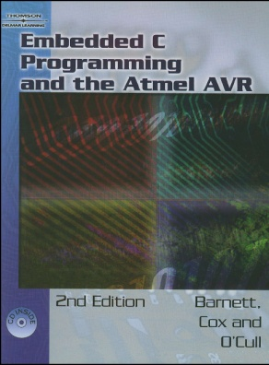
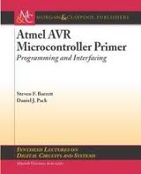
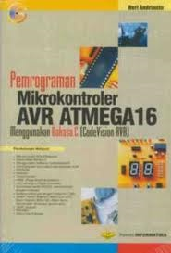
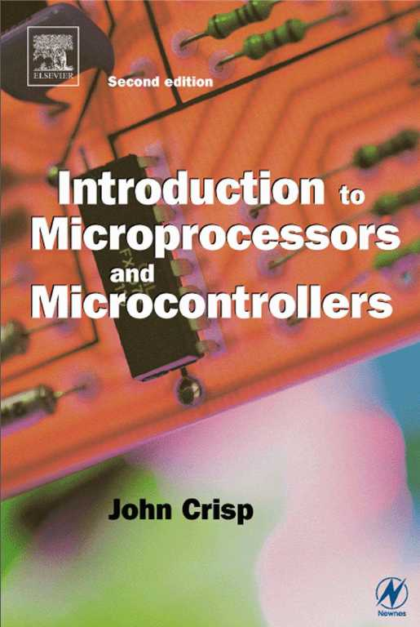
Sumber belajar :
Atmel AVR Microcontroller Primer: Programming and Interfacing by Steven F. Barrett
Embedded C Programming and the Atmel AVR by Richard H Barnet
Introduction to Microprocessors and Microcontrollers by John Crisp
Pemrograman Mikrokontroler AVR ATMega 16 oleh Heri Andrianto

Slide 6
Bobot Penilaian
No | Jenis penilaian | Skor maksimum
1 | Tugas | 25 %
2 | Partisipasi individu | 10 %
3 | UTS | 30 %
4 | UAS | 35 %

Slide 7
Ketentuan Penilaian
Tugas harus dilengkapi sebelum perkuliahan berakhir, jk tidak lengkap tidak boleh mengikuti ujian
Kehadiran kurang dari 75 % tdk boleh ikut ujian
Keterlambatan pengumpulan tugas dikenakan pengurangan nilai 10% tiap 1 minggu keterlambatan
UAS dan UTS bisa diperbaiki dengan soal yg sama dikumpulkan max 1 x 24 jam dan tdk boleh diwakilkan, tdk boleh diketik apalagi fotocopy

Slide 8
Materi
Arsitektur ATMega16
Pemrograman C
Pengenalan Codevision & Proteus
Input output
Interupt
ADC
Timer dan Counter
LCD
Aplikasi Kendali Motor

Slide 9
TERMINOLOGY
Microcontroller vs. Microprocessor vs. Microcomputer
A microprocessor is a central processing unit on a single chip.
A microprocessor combined with support circuitry , peripheral I/O components and memory (RAM & ROM) used to be called a “microcomputer.”
A microprocessor where all the components mentioned above are combined on the same single chip that the microprocessor is on, is called a microcontroller.
We will be using the ATMEGA 16 microcontroller.

Slide 10
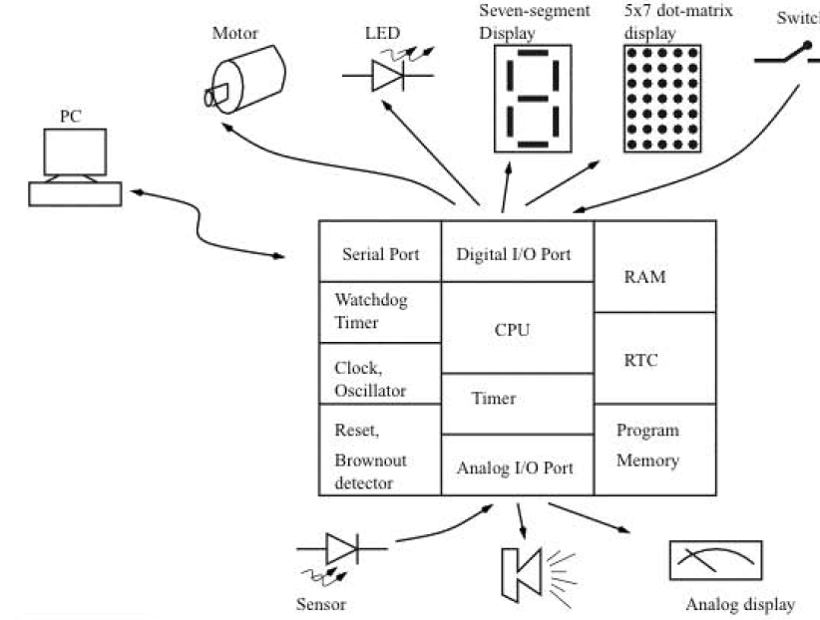
Microcontrollers
A microcontroller interfaces to external devices with a minimum of external components

Slide 11
MICRCONTROLLER ARCHITECTURE
1: CPU -- fetches the instructions stored in the program memory, decodes them, and executes them. The CPU itself is composed of registers the arithmetic logic unit, the instruction decoder and control circuitry.
2: PROGRAM MEMORY: The program memory stores the instructions that form the program. To accommodate larger programs, the program memory may be partitioned as internal program memory and external program memory (in some controllers). Program memory is usually nonvolatile and is of EEPROM, EPROM, Flash, or OTP (one-time programmable) type. [EEPROM for Atmega8].
3: RAM: The RAM is the data memory of the controller. The CPU uses RAM to store variables as well as the stack. The stack is used by the CPU to store return addresses from where to resume execution after it has completed a subroutine or an interrupt call.

Slide 12
MICRCONTROLLER ARCHITECTURE
4: CLOCK OSCILLATOR: The controller executes the program out of the program memory at a certain rate. This rate is determined by the frequency of the clock oscillator. The clock oscillator could be an internal RC-oscillator [this is the case for the Atmega 8], or an oscillator with an external timing element, such as a quartz crystal or RC circuit. As soon as power is applied to the controller, the oscillator starts operating.
5: RESET AND BROWNOUT DETECTOR CIRCUIT: The reset circuit in the controller ensures that at startup all the components and control circuits in the controller start at a predefined initial state and all the required registers are initialized properly.
The brownout detector is a circuit that monitors the power supply voltage, and if there is a momentary drop in voltage, resets the processor so that the drop in voltage does not corrupt register and memory contents, which could lead to faulty operations.

Slide 13
MICRCONTROLLER ARCHITECTURE
6: SERIAL PORT: The serial port can operate at any required data transfer speed. The serial port takes data bytes from the controller and shifts out the data one bit at a time to the output. Similarly, it accepts external data a bit at a time, makes a byte out of 8 such bits, and presents this to the controller.
7: DIGITAL I/O PORT: The microcontroller uses the digital I/O components to exchange digital data with the outside world. Compared to the serial port, which transfers data a bit at a time, the data from the I/O port is exchanged as bytes.
8: ANALOG I/O PORT: Analog input is performed using an analog-to-digital converter (ADC). The controller could be equipped with an integrated ADC or an analog comparator [the Atmega 8 has both (?)] , which is used under software control to perform A-to-D conversion. ADC’s are used to acquire senor data from devices such as temperature sensors and photocells. Such sensors often produce proportional analog voltage data.
Analog output is performed using a digital-to-analog converter (DAC) [must be externally in case of Atmega 8].
Most controllers are equipped with pulse-width modulators that can be used to get analog voltage with a suitable external RC filter [this is the case for the Atmega8]. DAC’s are used to drive motors, to generate sound, for visual displays.. (dimming LED’s).
[SENSORS assignment].

Slide 14
MICRCONTROLLER ARCHITECTURE
9: TIMER: The timer is used by the controller to time events. The timer can also be used as a counter.
10: WATCHDOG TIMER: A watchdog timer (WDT) is a special timer with a specific function. It is usually used to prevent software crashes.
11: RTC: A real time clock (RTC) is a special timer with the task of maintaining time of day, date etc.. . It can be used to time-stamp events [must be externally added to Atmega8].
-------------------------------------------------
Like microprocessors, microcontrollers are classified as 8-bit, 16-bit, etc.. . This refers to the width of the internal registers and the accumulator.
An 8-bit system usually also means that the CPU connects to the various chip component through an 8-bit data path.

Slide 15
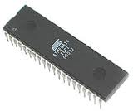
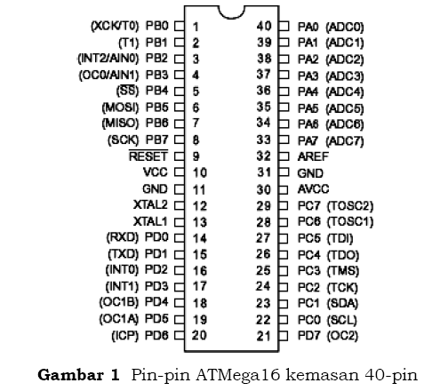

Slide 16
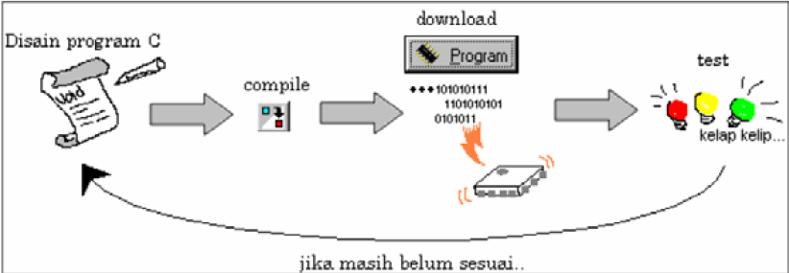
Alur pemrograman

Slide 17

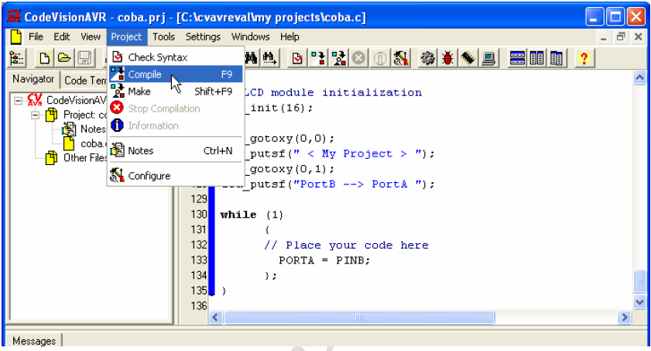

Slide 18
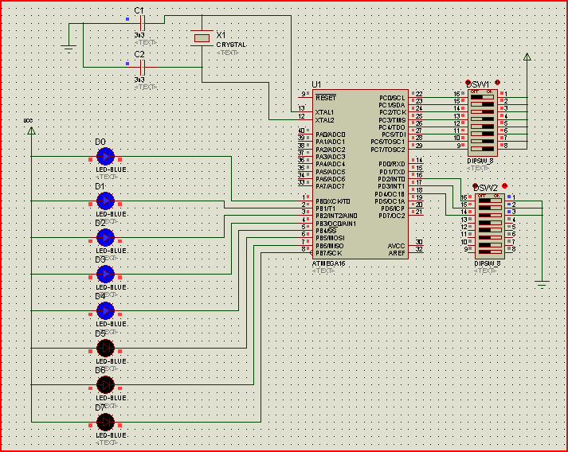
Proteus ISIS

Slide 19
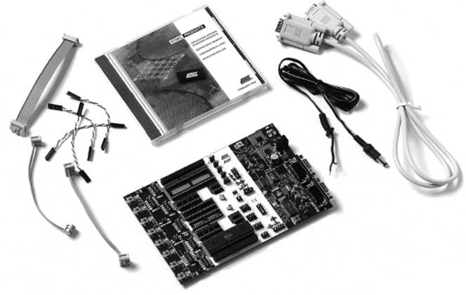
Downloader Microcontroller STK 500

Slide 20
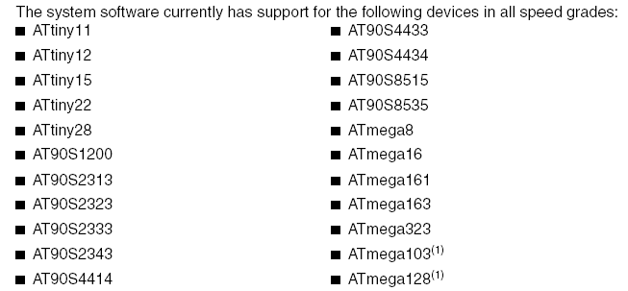
Used in Lab

Slide 21
AVR Architecture
• What are the features of RISC?
– 1 instruction per clock cycle (pipelined)
– Lots of registers: 32 GP registers
– Register-to-register operation
• Variations in the parts:
– TINY to MEGA
– ATtiny10
• Processor has only 8 pins
– ATmega128 (128K bytes flash)
• Processor has 64 pins

Slide 22
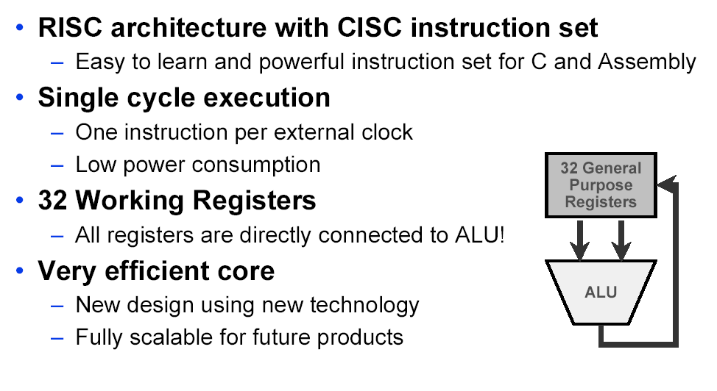
AVR Architecture

Slide 23
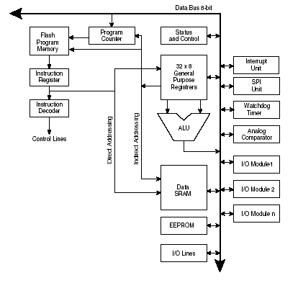
AVR RISC Architecture
Single Cycle Instructions: 8mhz = 8mips.
Large register file (32).
Every register an accumulator.
3 index register pairs
Register & IO are
mapped in SRAM space.

Slide 24

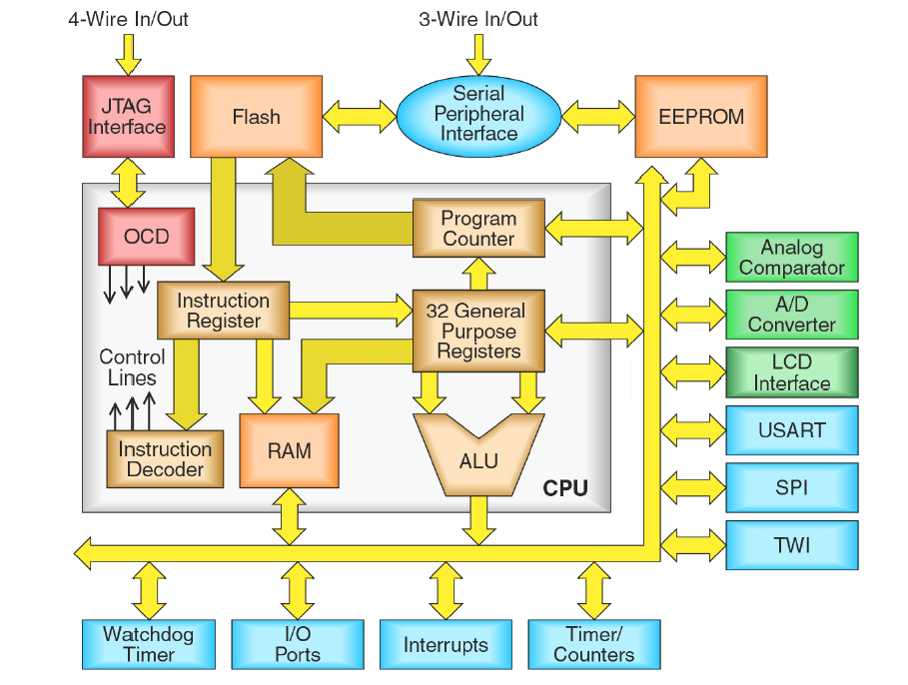
On Chip
Debugger
Two Wire Interface

Slide 25
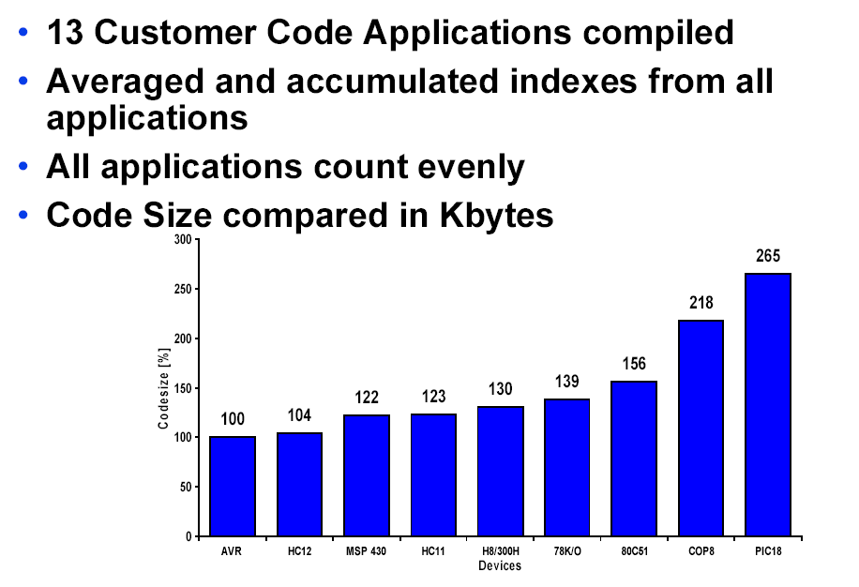

Slide 26
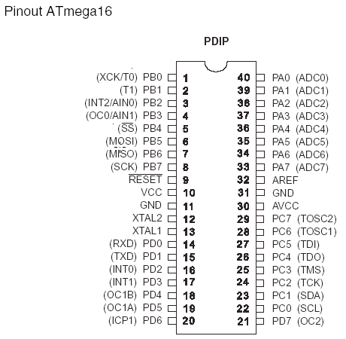
Typical Hardware Support
Internal or External Oscillator/Clock
Brown Out Detector
One or more timers
Two or more PWM
One or more USART
10 bit ADC
Analog Comparator
External interrupts

Slide 27
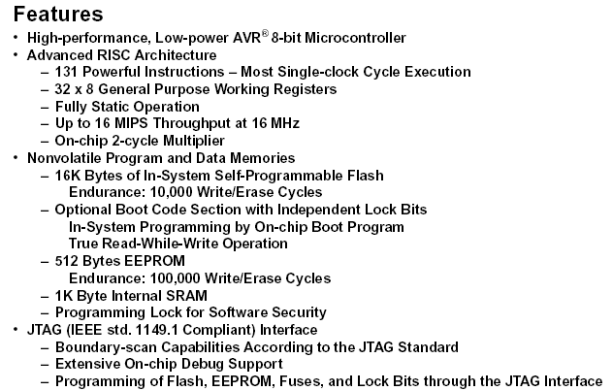

Slide 28
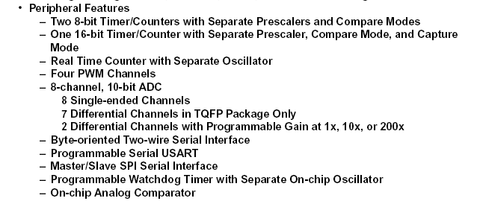

Slide 29
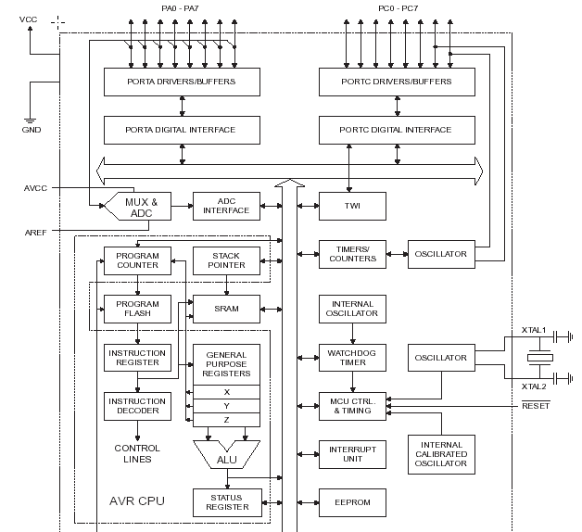

Slide 30
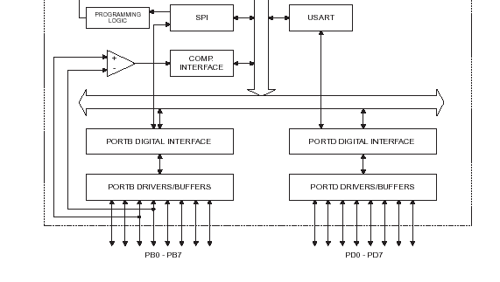
PB2 PB3 also used as Analog Input 0 (AIN0) and Analog Input 1 (AIN1)

Slide 31
The Analog Comparator compares
the input values on the positive pin AIN0 and negative pin
AIN1.
When the voltage on the positive pin AIN0 is higher than the voltage on the negative pin AIN1, the Analog Comparator Output, ACO, is set. ACO is kept in bit 5 of Analog Comparator Control and Status Register
The comparator’s output can be set to trigger the Timer/Counter1 Input Capture function. In addition, the comparator can trigger a separate interrupt, exclusive to the Analog Comparator.
The user can select Interrupt triggering on comparator
output rise, fall or toggle

Slide 32
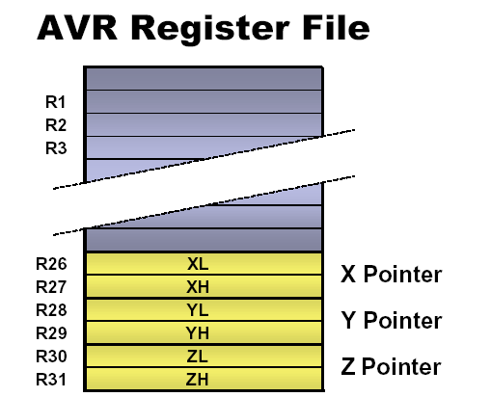
AVR Memory Space
• Program Flash
– Vectors, Code, and
(Unchangeable) Constant Data
• Working Registers
– Includes X, Y, and Z registers.
• I/O Register Space
– Includes “named” registers
• SRAM – Data Space
– Runtime Variables and Data
– Stack space
• EEPROM space
– For non-volatile but alterable data

Slide 33
AVR Addressing Modes
• Register Direct, with 1 and 2 registers
• I/O Direct
• Data Direct
• Data Indirect
– with pre-decrement
– with post-increment
• Code Memory Addressing

Slide 34
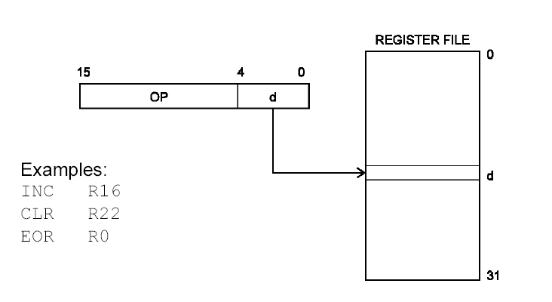
Register Direct: 1 Register

Slide 35
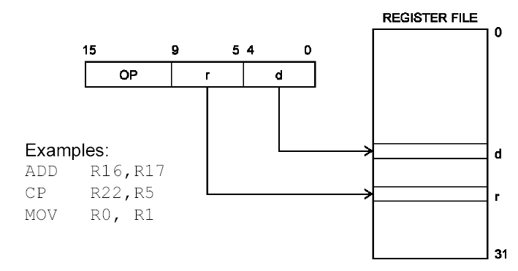
Register Direct: 2 Registers

Slide 36
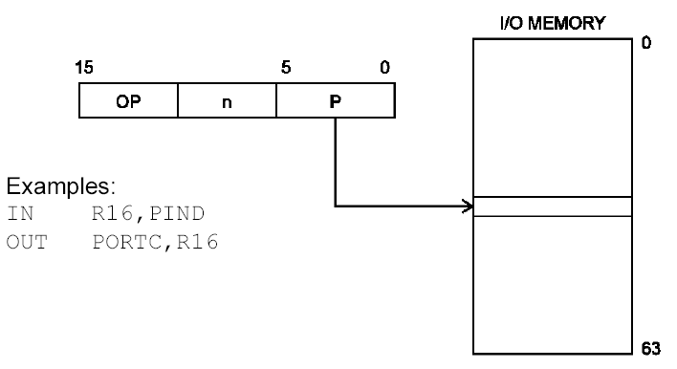
I/O Direct

Slide 37
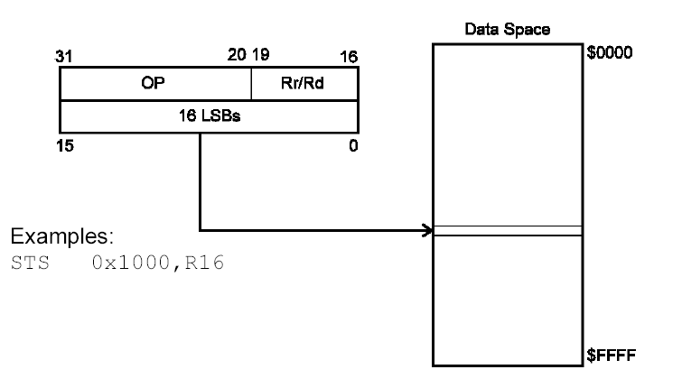
Data Direct
STS store direct to data space

Slide 38
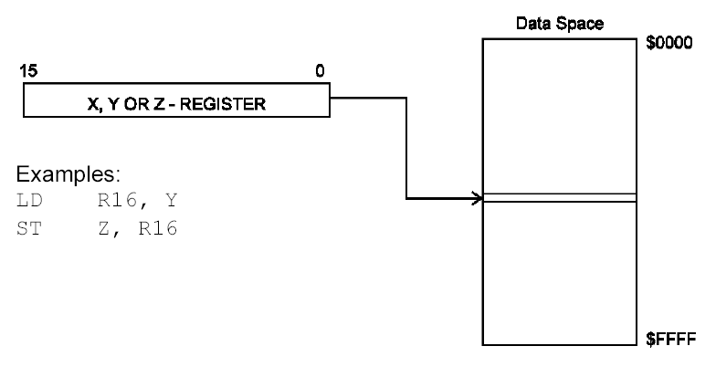
Data Indirect

Slide 39
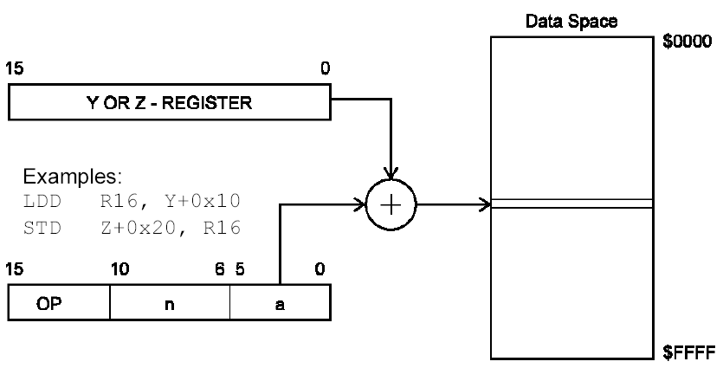
Data Indirect w/ Displacement

Slide 40
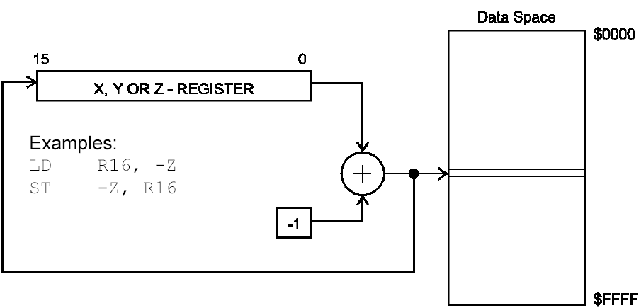
Data Indirect: Pre-Decrement

Slide 41
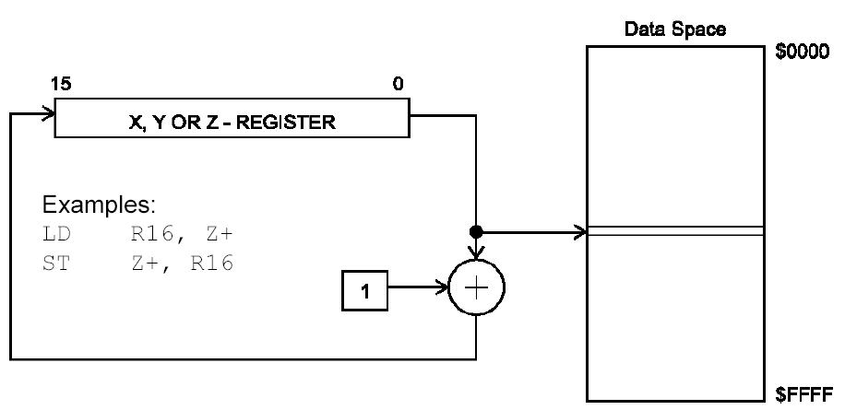
Data Indirect: Post-Increment

Slide 42
Status Register: SREG
Status Register (SREG)
SREG: Status Register
C: Carry Flag
Z: Zero Flag
N: Negative Flag
V: Two’s complement overflow indicator
S: N ⊕ V, For signed tests
H: Half Carry Flag
T: Transfer bit used by BLD (Bit load) and BST (Bit store) instructions
I: Global Interrupt Enable/Disable Flag

Slide 43
Interesting Instruction Examples:
• NOP – Do nothing for 1 cycle
• SLEEP – Sleep until reset or interrupted
• WDR – Watch Dog Reset
AVR Instruction set manual available in the course website

Slide 44
Timers: Why we need them
• Provide accurately timed delays or actions independent of code execution time
• How are Timers used?
– Accurate delay
• Read the timer, store value as K. Loop until timer reaches K+100.
– Schedule important events
• Setup an Output Compare to trigger an interrupt at a precise time
Port B pin3, PB3, when used as output port,
OC0 (Timer/Counter0 Output Compare Match Output)
(p.57 of Atmeg16 manual)
– Measure time between events
• When event#1 happens, store timer value as K
• When event#2 happens, read timer value and subtract K
• The difference is the time elapsed between the two events

Slide 45
AVR Timer/Counter 0
• 8 Bit
• Wrap-Around
Up Counter
• Interrupt on
overflow

Slide 46
AVR Timer/Counter 0
• 8 Bit Up Counter
– counts from 0 to 255 (0xFF), then loops to 0
– Internal or External Clock source
Prescaler
Output capture through OC0, i.e. PB3, pin 4
• Interrupt on Overflow
– Transition from 255 to 0 can trigger interrupt if
desired

Slide 47
AVR Timer/Counter 0
OC0, Output Compare Match output:
Whenever TCNT0 equals OCR0 (Output Compare Register 0), the comparator signals a match
The PB3 pin can serve as an external output for the Timer/Counter0 Compare Match. The PB3 pin has to be configured as an output

Slide 48
AVR Timer/Counter 1
– 16 Bit
– Dual Comparators A,B (output captures)
– Up Counter
– Interrupt on:
• Overflow
• Compare A/B
• Input Capture of external event on ICP pin.
– Can also act as an 8, 9 or 10 bit PWM Up-
Down Counter.

Slide 49
AVR Timer/Counter 1
The Input Capture unit of Timer/Counter captures external events and gives them a time-stamp indicating time of occurrence.
The external signal indicating an event, or multiple
events, can be applied via the ICP1 pin or alternatively, via the Analog Comparator unit.
The time-stamps can then be used to calculate frequency, duty-cycle, and other features of the signal applied.
Alternatively the time-stamps can be used for creating a log of the events.

Slide 50
Timer 1 and Output Compare
• The AVR has two output compares (OCR1A/B)
– OCR1A/B are 16-bit registers
– When the value of OCR1A/OCR1B matches that of Timer1:
• A user-defined action can take place on the OC1A/OC1B pin (set/clear/inv) i.e.,PD5 /PD4 need to set as output
• An interrupt can be triggered
• Timer1 can be cleared to zero
– Once set up, output compares operate continuously without
software intervention
– Great for:
• Precise recurring timing
• Frequency/Tone generation (maybe sound effects)
• All kinds of digital signal generation
– Infrared communications
– Software-driven serial ports

Slide 51
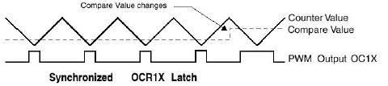
Timer 1 and PWM
• Pulse-Width Modulation
– Useful for using digital circuits to achieve analog- like control of motors, LEDs, etc
– Timer 1 has two channels of PWM output on OCR1A and OCR1B

Slide 52
Timer Control: I/O space
• Timer 0:
– Control Register (TCCR0) for clock selection, external clock or internal clock, prescaler etc.
– Timer/Counter 0(TCNT0) holding counter value
• Timer 1:
– Control Register A & B (TCCR1A/B)
– Input Capture Register (ICR1)
– Timer/Counter 1 Output Compare Register A and B
(OCR1A/B)
– Timer/Counter 1 (TCNT1)
• Timer Interrupt Registers (Mask and Flag Registers) are Common to Both Timers

Slide 53
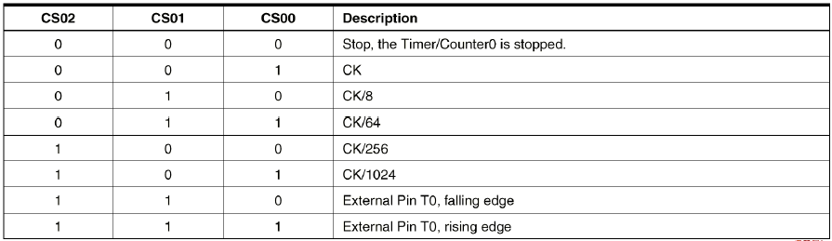
AVR Timer/Counter Sources
• Shut Off
• CPU frequency divided by 1,8,64,256,1024
• At 8MHz that’s: 1/8μs, 1 μs, 8 μs, 32 μs, 128 μs
• External Input (rising or falling).

Slide 54
Interrupts
• Interrupts halt normal code execution in order to go do something more important or time sensitive
• Interrupt “Handlers”
– Using the Interrupt Vectors
• Interrupts are used for:
– RESET
– Timers and Time-Critical Code
– Hardware signaling
• “I’m done”
• “Something’s happened that you want to know about”
• “I have something for you”

Slide 55
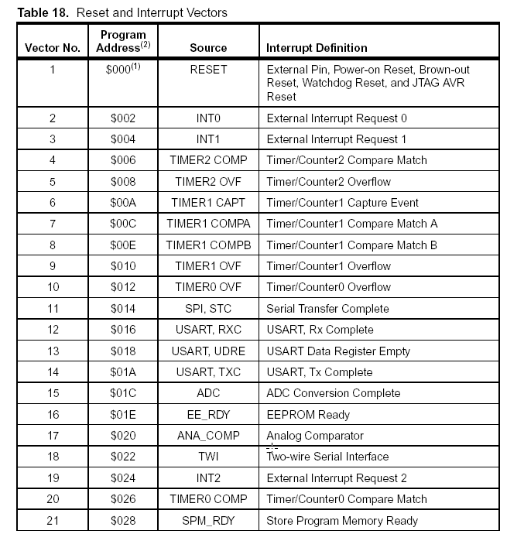

Slide 56
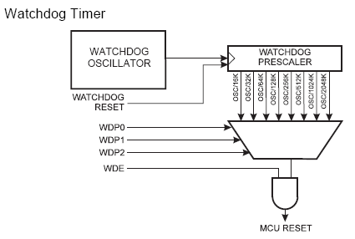
Watchdog Timer: reset the MCU
The Watchdog Timer is clocked from a separate On-chip Oscillator which runs at 1 MHz

Slide 57
Reading Assignment:
Chapter 1 of Embedded C Programming and the Atmel AVR

